Slide 1

第14单元
第55课 命令与程序
知识很简单 学习很快乐
《大数据离线计算》

Slide 2
前言
为什么要学习Zookeeper命令？

Slide 3
通过学习Zookeeper命令为以后管理Zookeeper打好基础

Slide 4

Part 01
Zookeeper命令操作

Slide 5
连接指定的zookeeper
./zkCli.sh -server ip:port

Slide 6
Zookeeper命令
ls /:列出“/”下面的其它的节点
create -e /name1 xiaozhang 创建临时节点，用quit命令退出或结束，会话节点消失
create -s /name2 xiaowang 创建顺序节点
creae -e -s /name3 xiaoli 创建临时数据节点
get /name 通过名字获取节点
rmr /name 删除指定名字的节点
set /name3 xiaoxiao

Slide 7
Part 02
Zookeeper开发环境

Slide 8
编写客户端程序步骤
在eclipse里建立java工程
将zookeeper涉及的jar包添加到构建路径（java build path）
创建java类
编写java代码创建操作zookeeper的客户端对象
编写java代码用zookeeper客户端对象操作zookeeper

Slide 9
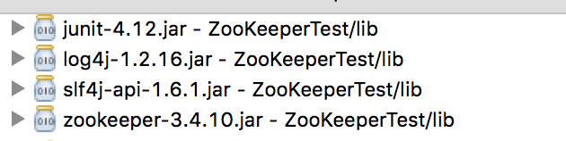
将zookeeper涉及到的jar添加到构建路径

Slide 10
Part 03
Zookeeper开发

Slide 11
编写java程序创建操作zookeeper的客户端对象
创建客户端连接对象
ZooKeeper client =
new ZooKeeper("172.16.245.5:2181"
,1000, null)

Slide 12
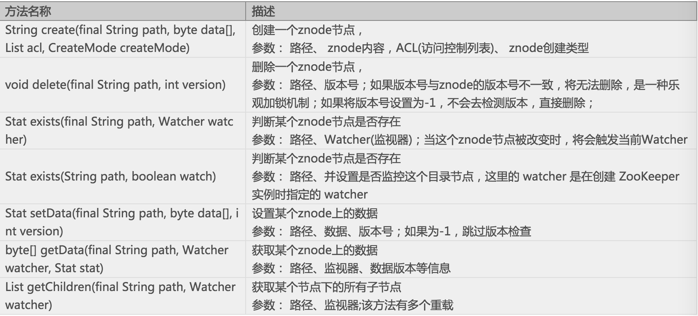
客户端方法

Slide 13
编写java程序用客户端对象操作zookeeper
创建name节点，name节点的内容是zhangsan,
String create = client.create("/name", "zhangsan".getBytes(), Ids.OPEN_ACL_UNSAFE, CreateMode.PERSISTENT);
/name 指定在”/”下创建一个znode节点name
Ids.OPEN_ACL_UNSAFE是将所有ADMIN之外的权限授予每个人
CreateMode.PERSISTENT 指定创建的节点是持久节点

Slide 14
将创建节点的代码完整实现如下
import java.io.IOException;
import org.apache.zookeeper.CreateMode;
import org.apache.zookeeper.KeeperException;
import org.apache.zookeeper.ZooKeeper;
import org.apache.zookeeper.ZooDefs.Ids;
public class TestZ {
public static void main(String[] args) throws IOException, KeeperException, InterruptedException {
ZooKeeper client = new ZooKeeper("172.16.245.5:2181"/*链接字符串*/, 1000, null);
String create = client.create(“/name”, “zhangsan”.getBytes(), Ids.OPEN_ACL_UNSAFE/*开放，任何应用都可以操作zookeeper*/, CreateMode.PERSISTENT);
System.out.println(create);
}
}

Slide 15
在name节点下创建一个子节点sex,存的内容是man
import java.io.IOException;
import org.apache.zookeeper.CreateMode;
import org.apache.zookeeper.KeeperException;
import org.apache.zookeeper.ZooKeeper;
import org.apache.zookeeper.ZooDefs.Ids;
public class TestZ {
public static void main(String[] args) throws IOException, KeeperException, InterruptedException {
ZooKeeper client = new ZooKeeper("172.16.245.5:2181"/*链接字符串*/, 1000, null);
String create = client.create("/name/sex", "man".getBytes()/*指定路径上存储的值*/, Ids.OPEN_ACL_UNSAFE, CreateMode.PERSISTENT/*持久化节点*/);
System.out.println(create);
}
}

Slide 16
获取指定节点“/name/sex”的内容
import java.io.IOException;
import org.apache.zookeeper.CreateMode;
import org.apache.zookeeper.KeeperException;
import org.apache.zookeeper.ZooKeeper;
import org.apache.zookeeper.ZooDefs.Ids;
public class TestZ {
public static void main(String[] args) throws IOException, KeeperException, InterruptedException {
ZooKeeper client = new ZooKeeper("172.16.245.5:2181"/*链接字符串*/, 1000, null);
byte[] data = client.getData(“/name/sex”/*指定节点*/, true, null);
String db = new String(data);//将获取的数据转换为字符串
System.out.println(db);//打印字符串
}
}

Slide 17
删除指定节点
import java.io.IOException;
import org.apache.zookeeper.CreateMode;
import org.apache.zookeeper.KeeperException;
import org.apache.zookeeper.ZooDefs.Ids;
import org.apache.zookeeper.ZooKeeper;
public class TestZ {
public static void main(String[] args) throws IOException, KeeperException, InterruptedException {
ZooKeeper client = new ZooKeeper("172.16.245.5:2181"/*链接字符串*/, 1000, null);
client.delete("/name1111", -1);
}
}

Slide 18
设置指定节点内容
import java.io.IOException;
import org.apache.zookeeper.KeeperException;
import org.apache.zookeeper.ZooKeeper;
public class Testset {
public static void main(String[] args) throws IOException, KeeperException, InterruptedException {
// TODO Auto-generated method stub
ZooKeeper zk = new ZooKeeper("172.16.245.5:2181", 1000, null);
zk.setData("/namewjf", "222222".getBytes(), zk.exists("/namewjf", true).getVersion()/*znode当前版本*/);
}
}

Slide 19
获取子节点
import java.io.IOException;
import java.util.List;
import org.apache.zookeeper.KeeperException;
import org.apache.zookeeper.ZooKeeper;
public class testgetchild { public static void main(String[] args) throws IOException, KeeperException, InterruptedException {
ZooKeeper client = new ZooKeeper("172.16.245.5:2181"/*链接字符串*/, 1000, null);
List<String> list = client.getChildren("/name", true);
for(String str:list){
System.out.println(str);
}
}
}

Slide 20
监听
public class TestWatcher implements Watcher{
//watcher只有在长链接的情况下才起作用,而且只能监听一次。
private static final int SESSION_TIMEOUT=1000;
private ZooKeeper zk = null;
public static void main(String[] args) throws IOException, KeeperException, InterruptedException {
ZooKeeper client = new ZooKeeper("172.16.245.5:2181"/*链接字符串*/, 1000, null);
byte[] bs = client.getData("/name", new TestWatcher(), null);
System.out.println(new String(bs));
Thread.sleep(Long.MAX_VALUE);
}
//监听到指定的目录有变化，会触发此方法
@Override
public void process(WatchedEvent event) {
System.out.println(event.getPath());
}
}

Slide 21
知识点总结
获取指定的节点的命令是？
创建持久节点的命令是？
创建临时节点的命令是？
创建顺序节点的命令是？
查看zookeeper进程的命令是？
停止zookeeper的命令是？
Zookeeper的节点被称为？
如何创建临时顺序节点？

Slide 22


创新教育 引领未来

